Slide 1
Bitcoin Price Prediction
By: Sadik Muktar, Regina Amel Christy, and Jaimie Koshy

Slide 2
Table of Contents
Goal
Data
Process
Model
Visualization

Slide 3
Goal
Our Goal is to find the price predictions of Bitcoins for 2021 by using a data set from 2016 to 2021 Historical Price data.

Slide 4
Introduction
What is Bitcoin?
Bitcoin is a cryptocurrency and a digital payment system , It is basically a computer file which stored in a 'digital wallet' app on a smartphone or computer. People can send Bitcoins (or part of one) to your digital wallet, and you can send Bitcoins to other people. Every single transaction is recorded in a public list called the blockchain.

Slide 5
Data Sources finance.yahoo.com
Yahoo
two datasets
Feb 8 2016 To
Feb 8 2021
Feb 9 2021 To
March 9 2021
Ticker symbol
BTC-USD

Slide 6
Programs and tools used
Jupyter Notebook and Visual Studio
HTML, CSS
Python Library
Pandas
Matplotlib
NumPy

Slide 7
ML libraries used
Scikit-learn library
Sklearn
Keras library and packages
Sequential model and Layers
Dense
LSTM
Dropout

Slide 8
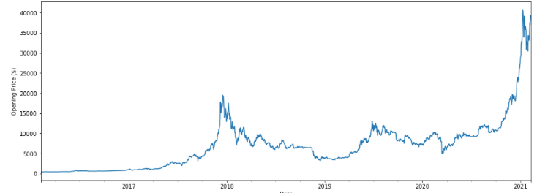
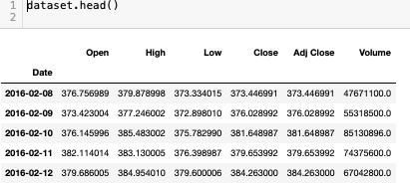
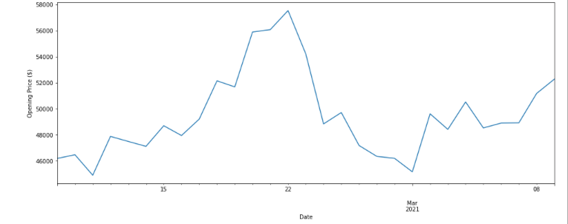
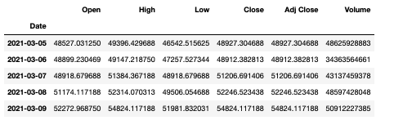
Data
Sample Dataset and Historical graph

Slide 9
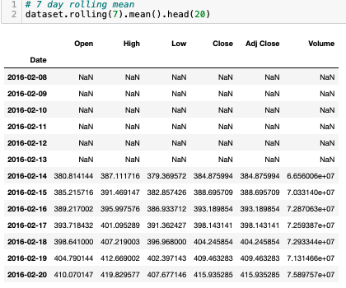
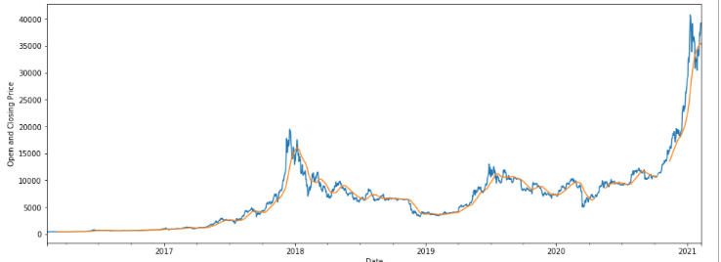
Opening and Closing price Chart
Rolling().mean()

Slide 10
Data Preprocessing
Min/Max Scaler
-Transform features(0, 1)

Slide 11
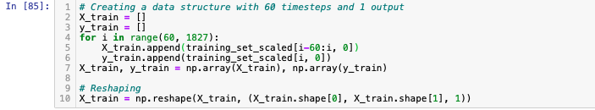
CREATE
X_train, y_train, 60 timesteps and one output

Slide 12
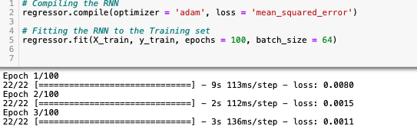

Building RNN
(recurring Neural Network)
Regressor
Sequential model
Compile our RNN
Optimizer we use

Slide 13
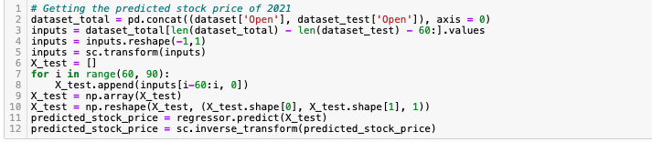
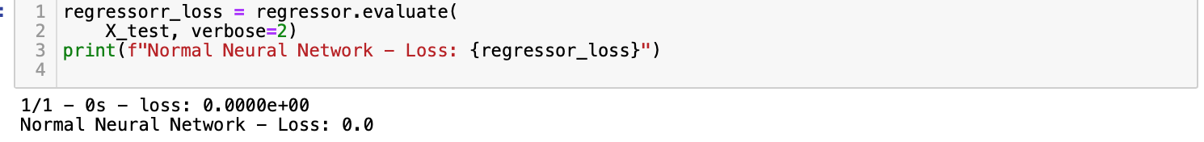
Predict Model

Slide 14



Model Data Processing
raw data
Predict
Model
Fit/Train
preprocessing

Slide 15
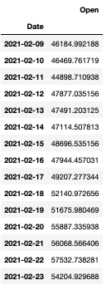
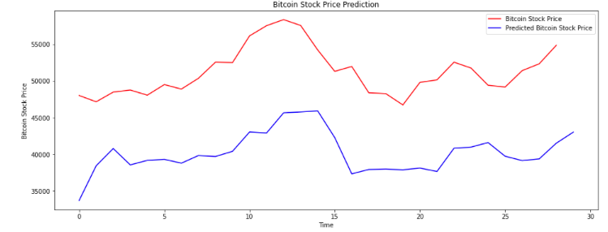

Bitcoin price prediction chart
Final Prediction Result

Slide 16

Connect ..….. Flask app
Data base
Html
CSS

Slide 17
Next
Our
Visualization

